Slide 1
SS ZG 566 Secure Software Engineering
T V Rao

Slide 2
Definitions and concepts of security - Part 1 RL 1.1.1

Slide 3
Security Problem
Organizations store, process, transmit their most sensitive information using software-intensive systems.
Private citizens depend on software to shop, bank, invest, and carry out most personal and social activities
Global connectivity makes the sensitive information and software systems vulnerable to unintentional and unauthorized use.

Slide 4
Security Problem
As per some experts, we are in era of
Information warfare
Cyber terrorism
Computer crime
Terrorists, Organized criminals, other criminals are targeting software-intensive systems and are able to gain entry.
There are many systems which can not resist attacks

Slide 5
Cyber Security Report to US President
Software development is not yet a science or a rigorous discipline, and the development process by and large is not controlled to minimize the vulnerabilities that attackers exploit. Today, as with cancer, vulnerable software can be invaded and modified to cause damage to previously healthy software, and infected software can replicate itself and be carried across networks to cause damage in other systems. Like cancer, these damaging processes may be invisible to the lay person even though experts recognize that their threat is growing.
- President’s Information Technology Advisory Committee[2005]

Slide 6
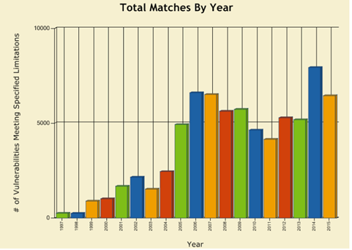
Trends of reported vulnerabilities
NVD is the U.S. government repository of standards based vulnerability management data. This data enables automation of vulnerability management, security measurement, and compliance
Source : National Vulnerability Database of NIST (National Institute of Standards and Technology)
URL: https://web.nvd.nist.gov/view/vuln/statistics-results?adv_search=true&cves=on&pub_date_start_month=0&pub_date_start_year=1997&pub_date_end_month=11&pub_date_end_year=2015&cvss_version=3

Slide 7
Growth of Threats
Growing internet connectivity of computers and networks and dependence on network-enabled services(e.g. email, online transactions) means
Increased number and sophistication of attack methods
Growing trend in which system accepts updates and extensions
Each new extension adds new capabilities, new interfaces, and thus new risks
Unbridled growth in the size and complexity of software systems
More lines of code produce more bugs and vulnerabilities

Slide 8
Security Principles
Saltzer and Schroeder defined security as “techniques that control who may use or modify the computer or the information contained in it”
Described the three main categories of concern:
Confidentiality
Integrity
Availability
Saltzer and Schroeder, “The Protection of Information in Computer Systems.” Communications of the ACM, 1974

Slide 9
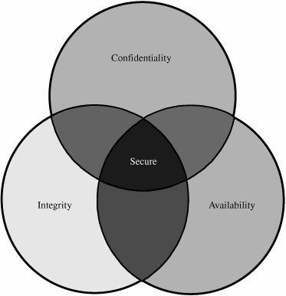
Security Principles
Integrity
Information be protected from improper modification
Availability
Available to user or program with legitimate right
Confidentiality
Protection of data from unauthorized disclosure
Relationship Between Confidentiality, Integrity, and Availability

Slide 10
Security Principles
Two additional properties commonly associated with human users are required in software entities that act as users, e.g. proxy agents, web services etc.
Accountability : All security-relevant actions of the software-as-user must be recorded and tracked with attribution, both while and after the recorded action occurs
Non-repudiation : Ability to prevent the software-as-user from disproving or denying responsibilities for actions it has performed

Slide 11
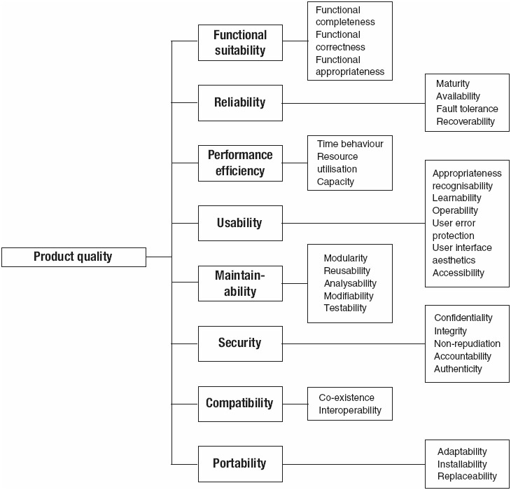
Product quality model of ISO/IEC 25010

Slide 12
Thank You!

Slide 13
SS ZG 566 Secure Software Engineering
T V Rao

Slide 14
Definitions and concepts of security - Part 2 RL 1.1.2

Slide 15
Software Assurance
The Committee on National Security Systems (CNSS) defines software assurance as follows:
“Software assurance (SwA) is the level of confidence that software is free from vulnerabilities, either intentionally designed into the software or accidentally inserted at any time during its life cycle, and that the software functions in the intended manner.”
Software assurance includes software reliability, software safety, and software security
Software assurance becomes important since critical infrastructure (viz. power, communication etc. ) depend on software-intensive systems

Slide 16
Processes for Secure Software
The most critical difference between secure and insecure software lies in the nature of the processes and practices used to specify, design, and develop the software
- Gortzel[2006]
Software vulnerabilities can originate from
Decisions made by software engineers
Flaws introduced in specification & design
Faults from developed code
Choice of programming language, development tools, operational environment etc.

Slide 17
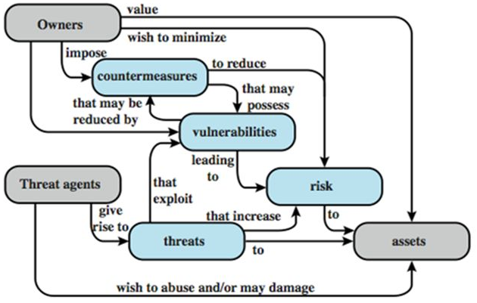
Security Concepts and Relationships

Slide 18
Security Concepts and Relationships
Threat
Any circumstance or event with the potential to adversely impact organizational operations (including mission, functions, image, or reputation), organizational assets, individuals, other organizations, or the Nation through an information system via unauthorized access, destruction, disclosure, modification of information, and/or denial of service. [CNSS 2010] 2. Any event that will cause an undesirable impact or loss to an organization if it occurs.
Vulnerability
Weakness in an information system, system security procedures, internal controls, or implementation that could be exploited by a threat source. [CNSS 2010] 2. The absence or weakness of a safeguard. It can also be described as a weakness in an asset or the methods of ensuring that the asset is survivable.
Risk
A measure of the extent to which an entity is threatened by a potential circumstance or event, and typically a function of 1) the adverse impacts that would arise if the circumstance or event occurs; and 2) the likelihood of occurrence.
Countermeasure
Actions, devices, procedures, or techniques that meet or oppose(i.e., counters) a threat, a vulnerability, or an attack by eliminating or preventing it, by minimizing the harm it can cause, or by discovering and reporting it so that corrective action can be taken. NIST SP 800-53: Actions, devices, procedures, techniques, or other measures that reduce the vulnerability of an information system. Synonymous with security controls and safeguards. [CNSS 2010]

Slide 19
Security Concepts and Relationships
The attack surface of a software environment is the sum of the different points (the "attack vectors") where an unauthorized user (the "attacker") can try to enter data to or extract data from an environment.
An attack vector is a path or means by which a hacker (or cracker) can gain access to a computer or network server in order to deliver a payload or malicious outcome.
If an attack vector is thought of as a guided missile (e.g. email), its payload can be compared to the warhead (e.g. malicious attachment) in the tip of the missile.

Slide 20
Security Concepts and Relationships
The principle of defense-in-depth is that layered security mechanisms increase security of the system as a whole. If an attack causes one security mechanism to fail, other mechanisms may still provide the necessary security to protect the system.
Social engineering attack is based on deceiving end users or administrators at a target site. Such attacks are typically carried out by email or by contacting users by phone and impersonating an authorized user, in an attempt to gain unauthorized access to a system or application

Slide 21
Security Concepts and Relationships
In computer security, a sandbox is a security mechanism for separating running programs. It is often used to execute untested code, or untrusted programs from unverified third parties, suppliers, untrusted users and untrusted websites. A sandbox typically provides a tightly controlled set of resources for guest programs to run in, such as disk and memory, network access, the ability to inspect the host system or read from input devices (disallowed or heavily restricted).
Sandboxes may be seen as a specific example of virtualization. Sandboxing is frequently used to test unverified programs that may contain a virus or other malicious code, without allowing the software to harm the host device

Slide 22
www.owasp.org
The Open Web Application Security Project (OWASP) is a worldwide not-for-profit charitable organization focused on improving the security of software. “Our mission is to make software security visible, so that individuals and organizations worldwide can make informed decisions about true software security risks.”
There are thousands of active wiki users around the globe who review the changes to the site to help ensure quality. Has a global group of volunteers with over 42,000 participants.

Slide 23
(Official website of the Department of Homeland Security)
https://buildsecurityin.us-cert.gov/
Build Security In is a collaborative effort that provides practices, tools, guidelines, rules, principles, and other resources that software developers, architects, and security practitioners can use to build security into software in every phase of its development.

Slide 24
www.cert.org
“At the Computer emergency response teams (CERT) Division of the Software Engineering Institute (SEI) of Carnegie Mellon University(CMU), we study and solve problems with widespread cybersecurity implications, research security vulnerabilities in software products, contribute to long-term changes in networked systems, and develop cutting-edge information and training to help improve cybersecurity.”
“We are more than a research organization. Working with software vendors, we help resolve software vulnerabilities. We develop tools, products, and methods to help organizations conduct forensic examinations, analyze vulnerabilities, and monitor large-scale networks. We help organizations determine how effective their security-related practices are”.

Slide 25
Thank You!

Slide 26
SS ZG 566 Secure Software Engineering
T V Rao

Slide 27
Threats to Software/Assets – Part 1 RL 1.2.1

Slide 28
The Asymmetric Problem of Security
No matter how much effort we spend, we will never get code 100 percent correct
This is an asymmetric problem
We must be 100 percent correct, 100 percent of time, on a schedule, with limited resources, only knowing what we know today
And the product has to be reliable, supportable, compatible, manageable, affordable, accessible, usable, global, doable, deployable.
They can spend as long as they like to find one bug, with the benefit of future research
www.microsoft.com

Slide 29
The Asymmetric Problem of Security
Tools make it easy to build exploit code
Reverse engineering tools
Situation explained
Structural Comparison of Executable Objects by Halvar Flake (available at https://static.googleusercontent.com/media/www.zynamics.com/en//downloads/dimva_paper2.pdf)
PCT Bug – “Detecting and understanding the vulnerability took less than 30 minutes”
H.323 ASN.1 Bug: “The total analysis took less than 3 hours time”
Exploitation
Penetration testing tools e.g. www.metaspoilt.com

Slide 30
The Asymmetric Problem of Security
In general
Cost for attacker to build attack is very low
Cost to your users is very high
Cost of reacting is higher than cost of defending

Slide 31
Hacking a Politician email
Hacker chooses to hack politician’s mail account and possibly impact elections(2008)
The approach was
Find the mail id
Use Forgot Password feature
The mail provider asks standard personal questions
The politician biography is well known

Slide 32
Security on Cloud (Example)
Code Spaces kept up their security measures, ensured that their server security was tight, and relied on Amazon for the bulk of their infrastructure -- like thousands of other companies.
The attack that brought Code Spaces under was as simple as gaining access to its AWS control panel.
Code Spaces was built mostly on AWS, using storage and server instances to provide its services. Those server instances weren't hacked, nor was Code Spaces' database compromised or stolen.
Attacker gained access to the company's AWS control panel & deleted resources on the cloud.
The demise of Code Spaces at the hands of an attacker shows that, in the cloud, off-site backups and separation of services could be key to survival
http://www.infoworld.com/article/2608076/data-center/murder-in-the-amazon-cloud.html 23 June 2014

Slide 33
In the space of one hour, my entire digital life was destroyed. First my Google account was taken over, then deleted. Next my Twitter account was compromised, and used as a platform to broadcast racist and homophobic messages. And worst of all, my AppleID account was broken into, and my hackers used it to remotely erase all of the data on my iPhone, iPad, and MacBook.
My accounts were daisy-chained together. Getting into Amazon let my hackers get into my Apple ID account, which helped them get into Gmail, which gave them access to Twitter.
Mat Honan, Sr. Staff Writer, wired.com
http://www.wired.com/2012/08/apple-amazon-mat-honan-hacking/all/

Slide 34
Gmail lets you reset your password if you forget, as do pretty much every other system. And the way you do a reset at Gmail is you send them a reset request. What they do is they send you a recovery link to a backup email address, or some other email address that you have. And helpful, they actually print the email address for you. So for this guy's account, someone went and asked Gmail to reset the password. And they said, well, yeah. Sure. We just sent the recovery link to this email, victim@me.com, which was some Apple email service.
But they want to get this password reset link to get access to Gmail. Well, the way things worked was that, in Apple's case, this me.com site, allowed you to actually reset your password if you know your billing address and the last four digits of your credit card number. The home address, could be looked up somewhere. But where do you get the last four digits of his credit card number?
The victim had an account at Amazon, which is another party in this story. Amazon really wants you to buy things. And as a result, they actually have a fairly elaborate account management system. And in particular, because they really want you to buy stuff, they don't require you to sign in in order to purchase some item with a credit card.
First you call Amazon and tell them you are the account holder, and want to add a credit card number to the account. All you need is the name on the account, an associated e-mail address, and the billing address. Amazon then allows you to input a new credit card. Next you call back, and tell Amazon that you’ve lost access to your account. Upon providing a name, billing address, and the new credit card number you gave the company on the prior call, Amazon will allow you to add a new e-mail address to the account. From here, you go to the Amazon website, and send a password reset to the new e-mail account. This allows you to see all the credit cards on file for the account — not the complete numbers, just the last four digits. But, as we know, Apple only needs those last four digits.

Slide 35
Panama Papers
As per Forbes, data security experts noted that the company had not been encrypting its emails and furthermore seemed to have been running a three-year-old version of Drupal with several known vulnerabilities. Some reports also suggest that some parts of the site may have been running WordPress with an out of date version of Revolution Slider, a plugin that has suffered from vulnerabilities in the past.
Drupal has over 100 reported vulnerabilities in CVE database.
e.g. CVE-2016-3171 : Drupal 6.x before 6.38, when used with PHP before 5.4.45, 5.5.x before 5.5.29, or 5.6.x before 5.6.13, might allow remote attackers to execute arbitrary code via vectors related to session data truncation.

Slide 36
If it wasn't clear before, it certainly is now: Your username and password are almost impossible to keep safe.
Nearly 443,000 e-mail addresses and passwords for a Yahoo site were exposed late Wednesday. The impact stretched beyond Yahoo because the site allowed users to log in with credentials from other sites -- which meant that user names and passwords for Yahoo (YHOO, Fortune 500), Google's (GOOG, Fortune 500) Gmail, Microsoft's (MSFT, Fortune 500) Hotmail, AOL (AOL) and many other e-mail hosts were among those posted publicly on a hacker forum.
What's shocking about the development isn't that usernames and passwords were stolen -- that happens virtually every day. The surprise is how easily outsiders cracked a service run by one of the biggest Web companies in the world.
The group of seven hackers, who belong to a hacker collective called D33Ds Company, got into Yahoo's Contributor Network database by using a rudimentary attack called a SQL injection.
http://money.cnn.com/2012/07/12/technology/yahoo-hack/

Slide 37
Thank You!

Slide 38
SS ZG 566 Secure Software Engineering
T V Rao

Slide 39
Threats to Software/Assets – Part 2 RL 1.2.2

Slide 40
Attack surfaces
Attack surface: the reachable and exploitable vulnerabilities in a system
Open ports
Services outside a firewall
An employee with access to sensitive info
…
Three categories
Network attack surface (i.e., network vulnerability)
Software attack surface (i.e., software vulnerabilities)
Human attack surface (e.g., social engineering)
Attack analysis: assessing the scale and severity of threats

Slide 41
Automotive Attack Surface
Modern cars are controlled by complex distributed computer systems comprising millions of lines of code executing on tens of heterogeneous processors with rich connectivity provided by internal networks (e.g., Controller Area Network CAN).
This structure has offers significant benefits to efficiency, safety and cost, but also creates the opportunity for new attacks.
An attacker connected to a car’s internal network can circumvent all computer control systems, including safety critical elements such as the brakes and engine.
The long-range wireless attack surface is that exposed by the remote telematics systems (e.g., Ford’s Sync, GM’s OnStar, Toyota’s SafetyConnect, Lexus’ Enform, BMW’s BMW Assist, and Mercedes-Benz’ mbrace) that provide continuous connectivity via cellular voice and data networks for supporting safety (crash reporting), diagnostics (early alert of mechanical issues), anti-theft (remote track and disable), and convenience (hands-free data access such as driving directions or weather).
Comprehensive Experimental Analyses of Automotive Attack Surfaces Stephen Checkoway, Damon McCoy, Brian Kantor, Danny Anderson, Hovav Shacham, and Stefan Savage University of California, San Diego
Karl Koscher, Alexei Czeskis, Franziska Roesner, and Tadayoshi Kohno University of Washington USENIX Security, August 10–12, 2011

Slide 42
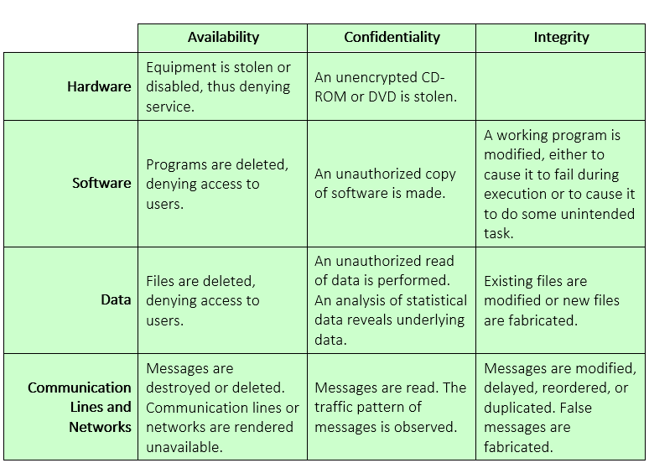
Examples of threats

Slide 43
Data in Transit
Attacks on data in networks can be
Passive attacks : eavesdropping on, or monitoring of transmissions
Release of message contents
Traffic analysis : Encrypted message can not be read. Location, identity of host, frequency, and length of messages can help opponents make guess
Active attacks
Replay : passive capture of data & subsequent retransmission to produce an unauthorized effect
Masquerade : one entity pretends to be another entity.
Modification of messages : some portion of a legitimate message is altered.
Denial of service : inhibit normal use of facilities

Slide 44
Attack trees
A branching, hierarchical data structure that represents a set of potential vulnerabilities
Objective: to effectively exploit the info available on attack patterns
published on CERT or similar forums
Security analysts can use the tree to guide design and strengthen countermeasures

Slide 45
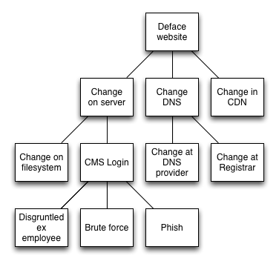
An attack tree (to deface a web site)
Content delivery network (CDN) : System of distributed servers (network) that deliver webpages and other Web content to user based on the geographic locations
Domain Name System (DNS) : Hierarchical decentralized naming system for computers, services, or any resource connected to the Internet or a private network
CMS : Content Management System
http://ertw.com/blog/2015/01/06/thinking-about-cyber-security/

Slide 46
Thank You!

Slide 47
SS ZG 566 Secure Software Engineering
T V Rao

Slide 48
Malware Nomenclature – Part 1 RL 1.3.1

Slide 49
Malware
“A program that is inserted into a system, usually covertly, with the intent of compromising the confidentiality, integrity, or availability of the victim’s data, applications, or operating system or otherwise annoying or disrupting the victim.”

Slide 50
Malicious software
Programs exploiting system vulnerabilities
Known as malicious software or malware
program fragments that need a host program
e.g. viruses, logic bombs, and backdoors
independent self-contained programs
e.g. worms, bots
replicating or not
Sophisticated threat to computer systems
Notes:
Perhaps the most sophisticated types of threats to computer systems are presented by programs that exploit vulnerabilities in computing systems. Such threats are referred to as malicious software, or malware. In this context, we are concerned with application programs as well as utility programs, such as editors and compilers, and kernel-level programs. This chapter examines malicious software, with a special emphasis on viruses and worms. The chapter begins with a survey of various types of malware, with a more detailed look at the nature of viruses and worms. We then turn to bots and rootkits. Throughout, the discussion presents both threats and countermeasures.
Malicious software can be divided into two categories: those that need a host program, and those that are independent. The former are essentially fragments of programs that cannot exist independently of some actual application program, utility, or system program. Viruses, logic bombs, and backdoors are examples. The latter are self-contained programs that can be scheduled and run by the operating system. Worms and bot programs are examples.
We can also differentiate between those software threats that do not replicate and those that do. The former are programs or fragments of programs that are activated by a trigger. Examples are logic bombs, backdoors, and bot programs. The latter consist of either a program fragment or an independent program that, when executed, may produce one or more copies of itself to be activated later on the same system or some other system. Viruses and worms are examples.

Slide 51
Malware Terminology
Virus: attaches itself to a program
Worm: propagates copies of itself to other computers
Logic bomb: “explodes” when a condition occurs
Trojan horse: fakes/contains additional functionality
Backdoor (trapdoor): allows unauthorized access to functionality
Mobile code: moves unchanged to heterogeneous platforms
Auto-rooter Kit (virus generator): malicious code (virus) generators
Spammer and flooder programs: large volume of unwanted “pkts”
Keyloggers: capture keystrokes
Rootkit: sophisticated hacker tools to gain root-level access
Zombie: software on infected computers that launch attack on others (aka bot)
Notes:
The terminology in this area presents problems because of a lack of universal agreement on all of the terms and because some of the categories overlap. Table 7.1 from the text, based on [SZOR05], is a useful guide.
Name Description
Virus attaches itself to a program and propagates copies of itself to other programs
Worm program that propagates copies of itself to other computers
Logic bomb triggers action when condition occurs
Trojan horse program that contains unexpected additional functionality
Backdoor program modification that allows unauthorized access to functionality
Mobile code software that can be shipped unchanged to a heterogeneous collection of platforms and execute with identical semantics
Auto-rooter malicious hacker tools used to break into new machines remotely Kit (virus generator) Set of tools for generating new viruses automatically
Spammer and Flooder programs are used to send large volumes of unwanted e-mail, or to attack systems with a large volumes of traffic to carry out a DoS attack
Keyloggers captures keystrokes on a compromised system
Rootkit set of hacker tools used after attacker has broken into a computer system and gained root-level access
Zombie program on infected machine activated to launch attacks on other machines

Slide 52
More terms
Payload: actions of the malware
Crimeware: kits for building malware; include propagation and payload mechanisms
Zeus, Sakura, Blackhole, Phoenix
APT (advanced persistent threats)
Advanced: sophisticated
Persistent: attack over an extended period of time
Threat: selected targets (capable, well-funded attackers)

Slide 53
Viruses
Piece of software that infects programs
modifying them to include a copy of the virus
so it executes secretly when host program is run
Specific to operating system and hardware
taking advantage of their details and weaknesses
A typical virus goes through phases of:
dormant: idle
propagation: copies itself to other program
triggering: activated to perform functions
execution: the function is performed
Biological Virus : Tiny scraps of genetic code – DNA or RNA – that can take over a living cell and trick it into making replicas of the original virus
Notes:
A virus is a piece of software that can "infect" other programs by modifying them; the modification includes a copy of the virus program, which can then go on to infect other programs. A virus can do anything that other programs do. The difference is that a virus attaches itself to another program and executes secretly when the host program is run. Once a virus is executing, it can perform any function, such as erasing files and programs. Most viruses carry out their work in a manner that is specific to a particular operating system and, in some cases, specific to a particular hardware platform. Thus, they are designed to take advantage of the details and weaknesses of particular systems. During its lifetime, a typical virus goes through the following four phases:
• Dormant phase: The virus is idle. The virus will eventually be activated by some event, such as a date, the presence of another program or file, or the capacity of the disk exceeding some limit. Not all viruses have this stage.
• Propagation phase: The virus places an identical copy of itself into other programs or into certain system areas on the disk. Each infected program will now contain a clone of the virus, which will itself enter a propagation phase.
• Triggering phase: The virus is activated to perform the function for which it was intended. As with the dormant phase, the triggering phase can be caused by a variety of system events, including a count of the number of times that this copy of the virus has made copies of itself.
• Execution phase: The function is performed, which may be harmless, e.g. a message on the screen, or damaging, e.g. the destruction of programs and data files

Slide 54
Virus structure
Components:
infection mechanism: enables replication
trigger: event that makes payload activate
payload: what it does, malicious or benign
Prepended/postpended/embedded
When infected program invoked, executes virus code then original program code
Can block initial infection (difficult) or propagation (with access controls)
Notes:
A computer virus has three parts [AYCO06]:
• Infection mechanism:The means by which a virus spreads, enabling it to replicate. The mechanism is also referred to as the infection vector.
• Trigger: event or condition determining when the payload is activated or delivered.
• Payload: What the virus does, besides spreading. The payload may involve damage or may involve benign but noticeable activity.
A virus can be prepended or postpended to an executable program, or it can be embedded in some other fashion. The key to its operation is that the infected program, when invoked, will first execute the virus code and then execute the original code of the program.
Once a virus has gained entry to a system by infecting a single program, it is in a position to infect some or all other executable files on that system when the infected program executes. Thus, viral infection can be completely prevented by preventing the virus from gaining entry in the first place. Unfortunately, prevention is extraordinarily difficult because a virus can be part of any program outside a system. Thus, unless one is content to take an absolutely bare piece of iron and write all one's own system and application programs, one is vulnerable. The lack of access controls on early PCs is a key reason why traditional machine code based viruses spread rapidly on these systems. In contrast, while it is easy enough to write a machine code virus for UNIX systems, they were almost never seen in practice due to the existence of access controls on these systems prevented effective propagation of the virus.

Slide 55
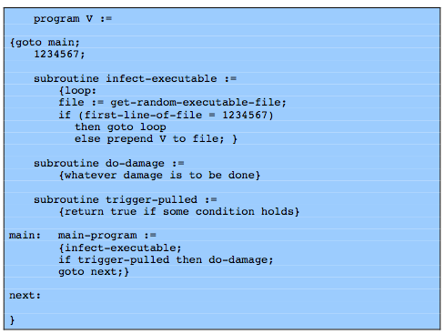
Virus structure
Notes:
A very general depiction of virus structure is shown in Figure 7.1 (based on [COHE94]). In this case, the virus code, V, is prepended to infected programs, and it is assumed that the entry point to the program, when invoked, is the first line of the program. An infected program begins with the virus code and works as follows. The first line of code is a jump to the main virus program. The second line is a special marker that is used by the virus to determine whether or not a potential victim program has already been infected with this virus. When the program is invoked, control is immediately transferred to the main virus program. The virus program first seeks out uninfected executable files and infects them. Next, the virus may perform some action, usually detrimental to the system. This action could be performed every time the program is invoked, or it could be a logic bomb that triggers only under certain conditions. Finally, the virus transfers control to the original program. If the infection phase of the program is reasonably rapid, a user is unlikely to notice any difference between the execution of an infected and uninfected program.

Slide 56
Virus classification
By target
boot sector: infect a master boot record
file infector: infects executable OS files
macro virus: infects files to be used by an app
multipartite: infects multiple ways
By concealment
encrypted virus: encrypted; key stored in virus
stealth virus: hides itself (e.g., compression)
polymorphic virus: recreates with diff “signature”
metamorphic virus: recreates with diff signature and behavior
Notes:
There has been a continuous arms race between virus writers and writers of antivirus software since viruses first appeared. As effective countermeasures have been developed for existing types of viruses, new types have been developed. A virus classification by target includes the following categories:
• Boot sector infector:Infects a master boot record or boot record and spreads when a system is booted from the disk containing the virus.
• File infector: Infects files that the operating system or shell consider to be executable.
• Macro virus: Infects files with macro code that is interpreted by an application.
A virus classification by concealment strategy includes the following categories:
• Encrypted virus: the virus creates a random encryption key, stored with the virus, and encrypts the remainder of the virus. When an infected program is invoked, the virus uses the stored random key to decrypt the virus. When the virus replicates, a different random key is selected.
• Stealth virus: A form of virus explicitly designed to hide itself from detection by antivirus software. Thus,the entire virus, not just a payload is hidden.
• Polymorphic virus: A virus that mutates with every infection, making detection by the “signature”of the virus impossible.
• Metamorphic virus: As with a polymorphic virus ,a metamorphic virus mutates with every infection. The difference is that a metamorphic virus rewrites itself completely at each iteration, increasing the difficulty of detection. Metamorphic viruses may change their behavior as well as their appearance.

Slide 57
Virus Variants
Macro and scripting viruses
Became very common in mid-1990s since
platform independent
infect documents
easily spread
Exploit macro capability of Office apps
executable program embedded in office doc
often a form of Basic
More recent releases include protection
Recognized by many anti-virus programs
E-Mail Viruses
More recent development
Example : Melissa
exploits MS Word macro in attached doc
if attachment opened, macro activates
sends email to all on users address list and does local damage
Notes:
In the mid-1990s, macro viruses became by far the most prevalent type of virus. Macro viruses are particularly threatening for a number of reasons:
1. A macro virus is platform independent. Virtually all of the macro viruses infect Microsoft Word documents. Any hardware platform and operating system that supports Word can be infected.
2. Macro viruses infect documents, not executable portions of code. Most of the information introduced onto a computer system is in the form of a document rather than a program.
3. Macro viruses are easily spread. A very common method is by electronic mail.
Macro viruses take advantage of a feature found in Word and other office applications such as Microsoft Excel, namely the macro. In essence, a macro is an executable program embedded in a word processing document or other type of file. Typically, users employ macros to automate repetitive tasks and thereby save keystrokes. The macro language is usually some form of the Basic programming language. A user might define a sequence of keystrokes in a macro and set it up so that the macro is invoked when a function key or special short combination of keys is input. Successive releases of Word provide increased protection against macro viruses. For example, Microsoft offers an optional Macro Virus Protection tool that detects suspicious Word files and alerts the customer to the potential risk of opening a file with macros. Various antivirus (A/V) product vendors have also developed tools to detect and correct macro viruses. As in other types of viruses, the arms race continues in the field of macro viruses, but they no longer are the predominant virus threat.

Slide 58
Thank You!

Slide 59
SS ZG 566 Secure Software Engineering
T V Rao

Slide 60
Malware Nomenclature – Part 2 RL 1.3.2

Slide 61
Worms
Replicating program that propagates over net
using email, remote exec, remote login
Has phases like a virus:
dormant, propagation, triggering, execution
propagation phase: searches for other systems, connects to it, copies self to it and runs
May disguise itself as a system process
Concept seen in Brunner’s “Shockwave Rider”
Implemented by Xerox Palo Alto labs in 1980’s
Notes:
A worm is a program that can replicate itself and send copies from computer to computer across network connections. Upon arrival, the worm may be activated to replicate and propagate again. In addition to propagation, the worm usually performs some unwanted function. Network worm programs use network connections to spread from system to system. Once active within a system, a network worm can behave as a computer virus or bacteria, or it could implant Trojan horse programs or perform any number of disruptive or destructive actions. To replicate itself, a network worm uses some sort of network vehicle such as email, remote execution or remote login capabilities. The new copy of the worm program is then run on the remote system where, in addition to any functions that it performs at that system, it continues to spread in the same fashion. A network worm exhibits the same characteristics as a computer virus: a dormant phase, a propagation phase, a triggering phase, and an execution phase. The propagation phase generally: searches for other systems to infect by examining host tables or similar repositories of remote system addresses; establishes a connection with a remote system; and copies itself to the remote system and cause the copy to be run. The network worm may also attempt to determine whether a system has previously been infected before copying itself to the system. In a multiprogramming system, it may also disguise its presence by naming itself as a system process or using some other name that may not be noticed by a system operator. The concept of a computer worm was introduced in John Brunner’s 1975 SF novel “The Shockwave Rider”. The first known worm implementation was done in Xerox Palo Alto Labs in the early 1980s. It was a nonmalicious search for idle systems to use to run a computationally intensive task. As with viruses, network worms are difficult to counter.

Slide 62
Morris worm
One of best know worms
Released by Robert Morris in 1988
Affected 6,000 computers; cost $10-$100 M
Various attacks on UNIX systems
cracking password file to use login/password to logon to other systems
exploiting a bug in the finger protocol
exploiting a bug in sendmail
If succeed have remote shell access
sent bootstrap program to copy worm over
Notes:
Until the current generation of worms, the best known was the worm released onto the Internet by Robert Morris in 1988. The Morris worm was designed to spread on UNIX systems and used a number of different techniques for propagation. When a copy began execution, its first task was to discover other hosts known to this host that would allow entry from this host. The worm performed this task by examining a variety of lists and tables, including system tables that declared which other machines were trusted by this host, users' mail forwarding files, tables by which users gave themselves permission for access to remote accounts, and from a program that reported the status of network connections. For each discovered host, the worm tried a number of methods for gaining access:
It attempted to log on to a remote host as a legitimate user, having cracked the local password file, and assuming that many users use the same password on different systems.
It exploited a bug in the finger protocol
It exploited a trapdoor in the debug option of the remote sendmail process.
If any of these attacks succeeded, the worm achieved communication with the operating system command interpreter. It then sent this interpreter a short bootstrap program, issued a command to execute that program, and then logged off. The bootstrap program then called back the parent program and downloaded the remainder of the worm. The new worm was then executed.

Slide 63
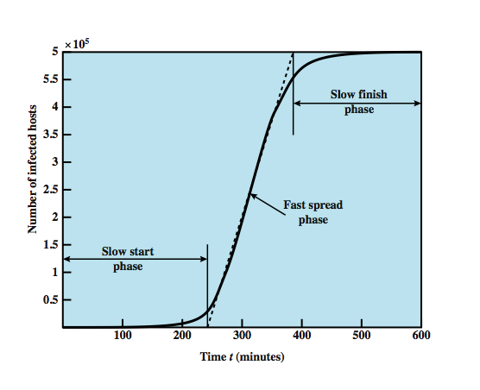
Worm Propagation Model (based on recent attacks)
linear rate of infection
exponential rate of infection
Notes:
[ZOU05] describes a model for worm propagation based on an analysis of recent worm attacks. The speed of propagation and the total number of hosts infected depend on a number of factors, including the mode of propagation, the vulnerability or vulnerabilities exploited, and the degree of similarity to preceding attacks. For the latter factor, a an attack that is a variation on a recent previous attack may be countered more effectively than a more novel attack. Figure 7.6 shows the dynamics for one, typical, set of parameters. Propagation proceeds through three phases. In the initial phase, the number of hosts increases exponentially. To see that this is so, consider a simplified case in which a worm is launched from a single host and infects two nearby hosts. Each of these hosts infects two more hosts, and so on. This results in exponential growth. After a time, infecting hosts waste some time attacking already-infected hosts, which reduces the rate of infection. During this middle phase, growth is approximately linear, but the rate of infection is rapid. When most vulnerable computers have been infected, the attack enters a slow finish phase as the worm seeks out those remaining hosts that are difficult to identify. Clearly, the objective in countering a worm is to catch the worm in its slow start phase, at a time when few hosts have been infected.

Slide 64
Some worm attacks
Code Red
July 2001 exploiting MS IIS bug
probes random IP address, does DDoS attack
consumes significant net capacity when active
360,000 servers in 14 hours
Code Red II variant includes backdoor: hacker controls the worm
SQL Slammer (exploited buffer-overflow vulnerability)
early 2003, attacks MS SQL Server
compact and very rapid spread
Mydoom (100 M infected messages in 36 hours)
mass-mailing e-mail worm that appeared in 2004
installed remote access backdoor in infected systems
Notes:
The contemporary era of worm threats began with the release of the Code Red worm in July of 2001. Code Red exploits a security hole in the Microsoft Internet Information Server (IIS) to penetrate and spread. It also disables the system file checker in Windows. The worm probes random IP addresses to spread to other hosts. During a certain period of time, it only spreads. It then initiates a denial-of-service attack against a government Web site by flooding the site with packets from numerous hosts. The worm then suspends activities and reactivates periodically. In the second wave of attack, Code Red infected nearly 360,000 servers in 14 hours. In addition to the havoc it causes at the targeted server, Code Red can consume enormous amounts of Internet capacity, disrupting service. Code Red II is a variant that targets Microsoft IISs. In addition, this newer worm installs a backdoor allowing a hacker to direct activities of victim computers.
In early 2003, the SQL Slammer worm appeared. This worm exploited a buffer overflow vulnerability in Microsoft SQL server. The Slammer was extremely compact and spread rapidly, infecting 90% of vulnerable hosts within 10 minutes. Late 2003 saw the arrival of the Sobig.f worm, which exploited open proxy servers to turn infected machines into spam engines. At its peak, Sobig.f reportedly accounted for one in every 17 messages and produced more than one million copies of itself within the first 24 hours.
Mydoom is a mass-mailing e-mail worm that appeared in 2004. It followed a growing trend of installing a backdoor in infected computers, thereby enabling hackers to gain remote access to data such as passwords and credit card numbers. Mydoom replicated up to 1000 times per minute and reportedly flooded the Internet with 100 million infected messages in 36 hours.

Slide 65
State of worm technology
Multiplatform: not limited to Windows
Multi-exploit: Web servers, emails, file sharing …
Ultrafast spreading: do a scan to find vulnerable hosts
Polymorphic: each copy has a new code
Metamorphic: change appearance/behavior
Transport vehicles (e.g., for DDoS)
Zero-day exploit of unknown vulnerability (to achieve max surprise/distribution)
Notes:
The state of the art in worm technology includes the following:
• Multiplatform: Newer worms are not limited to Windows machines but can attack a variety of platforms, especially the popular varieties of UNIX.
• Multi-exploit: New worms penetrate systems in a variety of ways, using exploits against Web servers, browsers, e-mail, file sharing, and other network-based applications.
• Ultrafast spreading: One technique to accelerate the spread of a worm is to conduct a prior Internet scan to accumulate Internet addresses of vulnerable machines.
• Polymorphic: To evade detection, skip past filters, and foil real-time analysis, worms adopt the virus polymorphic technique. Each copy of the worm has new code generated on the fly using functionally equivalent instructions and encryption techniques.
• Metamorphic: In addition to changing their appearance, metamorphic worms have a repertoire of behavior patterns that are unleashed at different stages of propagation.
• Transport vehicles: Because worms can rapidly compromise a large number of systems, they are ideal for spreading other distributed attack tools, such as distributed denial of service bots.
• Zero-day exploit: To achieve maximum surprise and distribution, a worm should exploit an unknown vulnerability that is only discovered by the general network community when the worm is launched.

Slide 66
Worm countermeasures
Overlaps with anti-virus techniques
Once worm on system A/V can detect
Worms also cause significant net activity
Worm defense approaches include:
signature-based worm scan filtering: define signatures
filter-based worm containment (focus on contents)
payload-classification-based worm containment (examine packets for anomalies)
threshold random walk scan detection (limit the rate of scan-like traffic)
rate limiting and rate halting (limit outgoing traffic when a threshold is met)
Notes:
There is considerable overlap in techniques for dealing with viruses and worms. Once a worm is resident on a machine, antivirus software can be used to detect it. In addition, because worms propagation generates considerable network activity, the monitoring of that activity can lead form the basis of a worm defense. Have classes:
Signature-based worm scan filtering: generates a worm signature, which is then used to prevent worm scans from entering/leaving a network/host.
Filter-based worm containment: focuses on worm content rather than a scan signature. The filter checks a message to determine if it contains worm code.
Payload-classification-based worm containment: examine packets to see if they contain a worm using anomaly detection techniques
Threshold random walk (TRW) scan detection: exploits randomness in picking destinations to connect to as a way of detecting if a scanner is in operation
Rate limiting: limits the rate of scanlike traffic from an infected host.
Rate halting: immediately blocks outgoing traffic when a threshold is exceeded either in outgoing connection rate or diversity of connection attempts. Rate halting can integrate with a signature- or filter-based approach so that once a signature or filter is generated, every blocked host can be unblocked; as with rate limiting, rate halting techniques are not suitable for slow, stealthy worms.

Slide 67
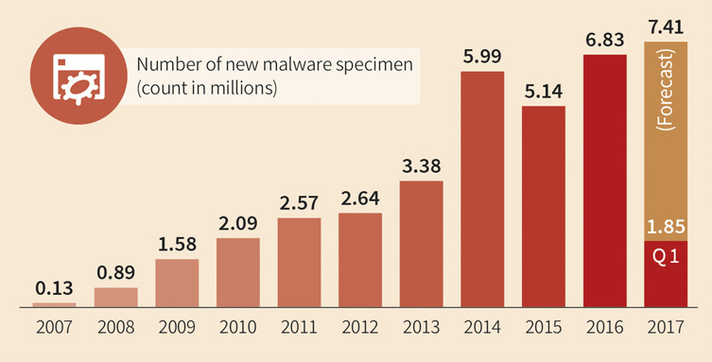
Malware Trends
www.gdatasoftware.com

Slide 68
Malware Trends
The vast majority of malware is categorized as Trojan Horse and comprises typical malicious activities like downloading and dropping files, spyware, keyloggers and password stealers, integration into botnets and conducting distributed denial of service attacks (DDoS).
Position two is held by adware.
A sharp rise could also be seen in ransomware(from a small base). Its number increased more than ninefold from the first half of 2016 to the second. Moreover, the number of the latter half of 2016 was almost achieved in the first quarter of 2017. Few ransomware families caused quite some stir.
www.gdatasoftware.com

Slide 69
Malware Trends
The predominant platform for malware is still Windows. It covers 99.1% of the malware specimen. Trailing behind are scripts, Java applets, macros and other operating systems like OSX, Android, and Unix/Linux.
The number of new malware is still rising.
No big changes in terms of malicious activities of Trojan horses
The number of adware is increasing
The share of ransomware is growing substantially.
www.gdatasoftware.com

Slide 70
Software Security Engineering, Julia H. Allen, et al, Pearson, 2008.
Computer Security: Principles and Practice by William Stallings, and Lawrie Brown Pearson, 2008.
Security in Computing by Charles P. Pfleeger, Shari L. Pfleeger, and Deven Shah Pearson Education 2009
Threat Modelling by Adam Shostack, John Wiley 2014
www.gdatasoftware.com

Slide 71
Thank You!

